Slide 1


RPA Fridays #26
UiPath Unattended Robot Setup (full tutorial) Working in January 2022
hello@robotict.com
www.robotict.com

Slide 2
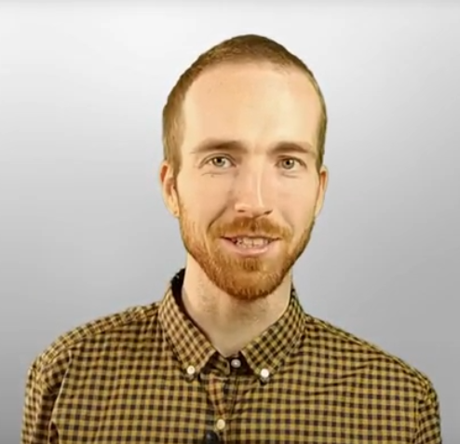
About me About us
Robot ICT, Czech Republic
IT & Process Automation
Software Development
Digital Network Automation
RPA solutions
RPA Academy
More about us – see links below!
Roman Hruška
RPA Developer
Academy trainer
Community leader
Let me automate it for you!
Ask questions in comments!
If you like this video, give it a 👍 and subscribe! Thank You!
Notes:
Hello, I'm Roman and I'm also part of the Robot ICT family, where we love to automate every process possible.
Some quick about Robot ICT. We are a Czech based company focussed on automation in different kind of industries. We do this by using RPA, which is Robotic Process Automation and we also use our own workflow automation software which is more specialized on networks, datacenters and large IT environments.
If you want to know more about Robot ICT, The Academy, Our Comminuty, all links are in the description below. If you will enjoy this webinar, please give us a like and subscribe, it would mean a lot to us.

Slide 3
What will I cover in this video tutorial?
Full setup of Unattended Robot in UiPath Orchestrator
Install Unattended Robot service on VM
Create a Robot User account in Automation Cloud
Creating Machine Template
Connecting with UiPath Assistant on the machine
Assigning Robot User account to Tenant and to Folder
Principles of Tenants, Folders, Robot Users…

Slide 4
Orchestrator
powerful
complex
complicated
confusing

Slide 5
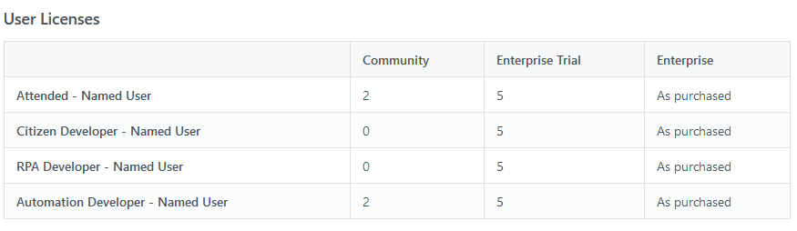
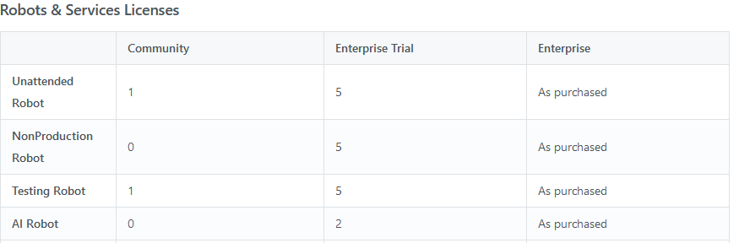
Licenses
https://docs.uipath.com/automation-cloud/docs/about-licensing

Slide 6
Structure of Orchestrator (Example setup)
Login to cloud.uipath.com
Organisation A
Development
Testing
Organisation B
Cloud
Organisations
Tenants
Folders
Organisation C
Production
Finance
HR
Operations
Finance
HR
Operations

Slide 7
Licenses – basic principles
Login to cloud.uipath.com
Organisation A
Development
Testing
Organisation B
Cloud
Organisations
Tenants
Folders
Organisation C
Production
Finance
HR
Operations
Finance
HR
Operations
Licenses:

Slide 8
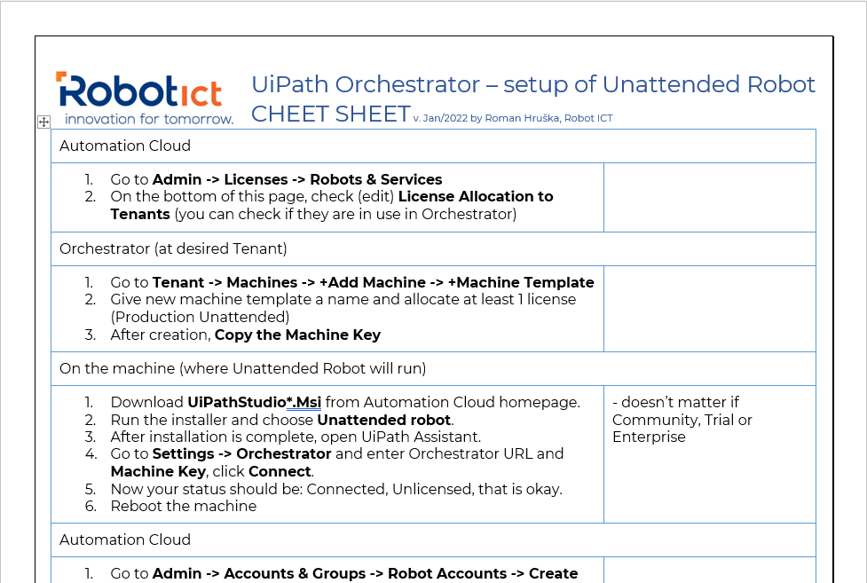

Slide 9

Questions, please!

Slide 10
Thank You for Your attention!
Download the cheet sheet → (1st link in video description)
Robot ICT Community Forum
RPA, Software Automation and more!
RPA Challenges
RPA Fridays
Sign up!
Please subscribe to Robot ICT channel
Facebook group, LinkedIn group
All links are in the video description!

Slide 11

Thank You for watching!
Happy automation!
hello@robotict.com
www.robotict.com

